Slide 1
TASK 2: FINDING VULNERABILITIES OF A GIVEN WEBSITE
Steps to process the automatic vulnerability scan using NETSPARKER :
STEP 1: Open NETSPARKER( Automatic Vulnerability Scanner).
STEP 2: Add the website you want to scan to the dialogue box. In our case https://zero.webappsecurity.com/
STEP 3: Define the customization options to scan.
STEP 4: Click on Start attack.
STEP 5: During the scanning many vulnerabilities of different level will start appearing.
STEP 6: Select any one of the CRITICAL vulnerability and write a report.

Slide 2
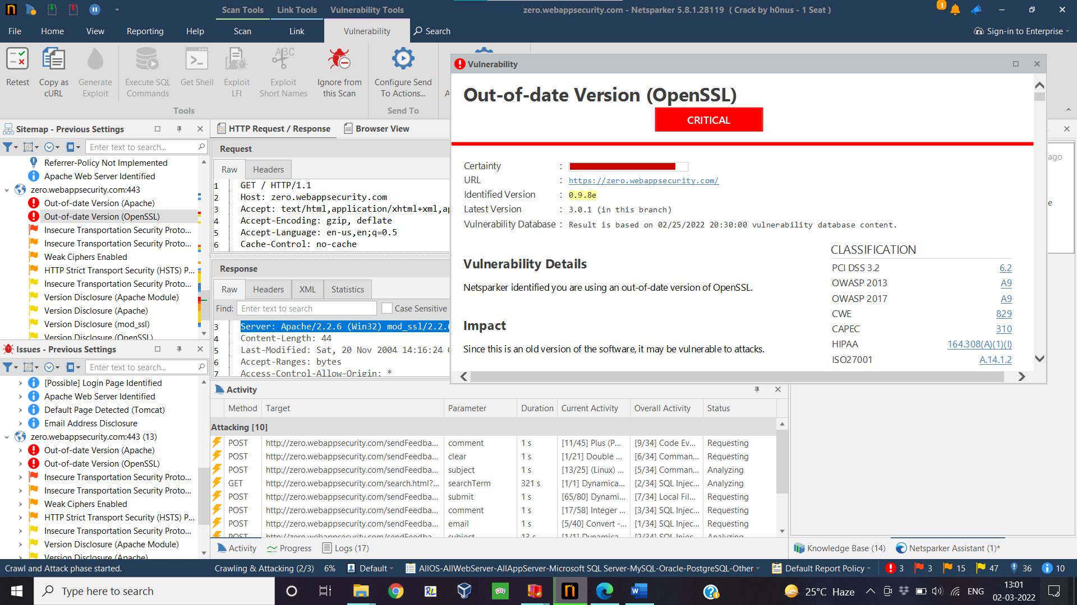

Slide 3
Report generated by NETSPARKER :

Slide 4
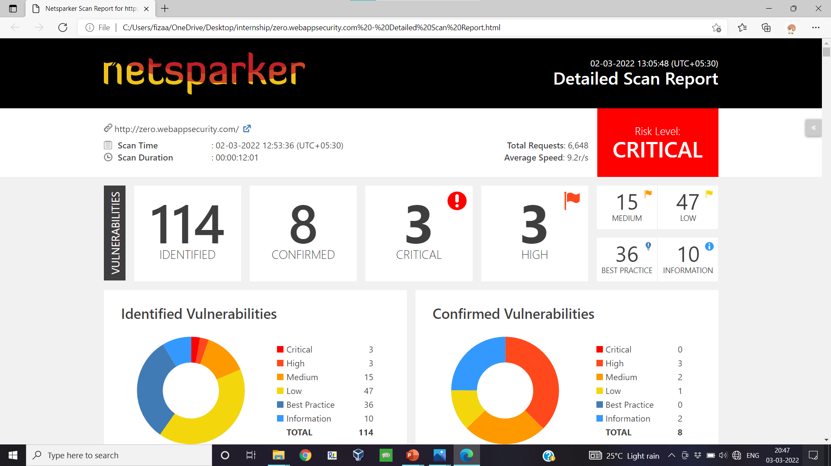

Slide 5
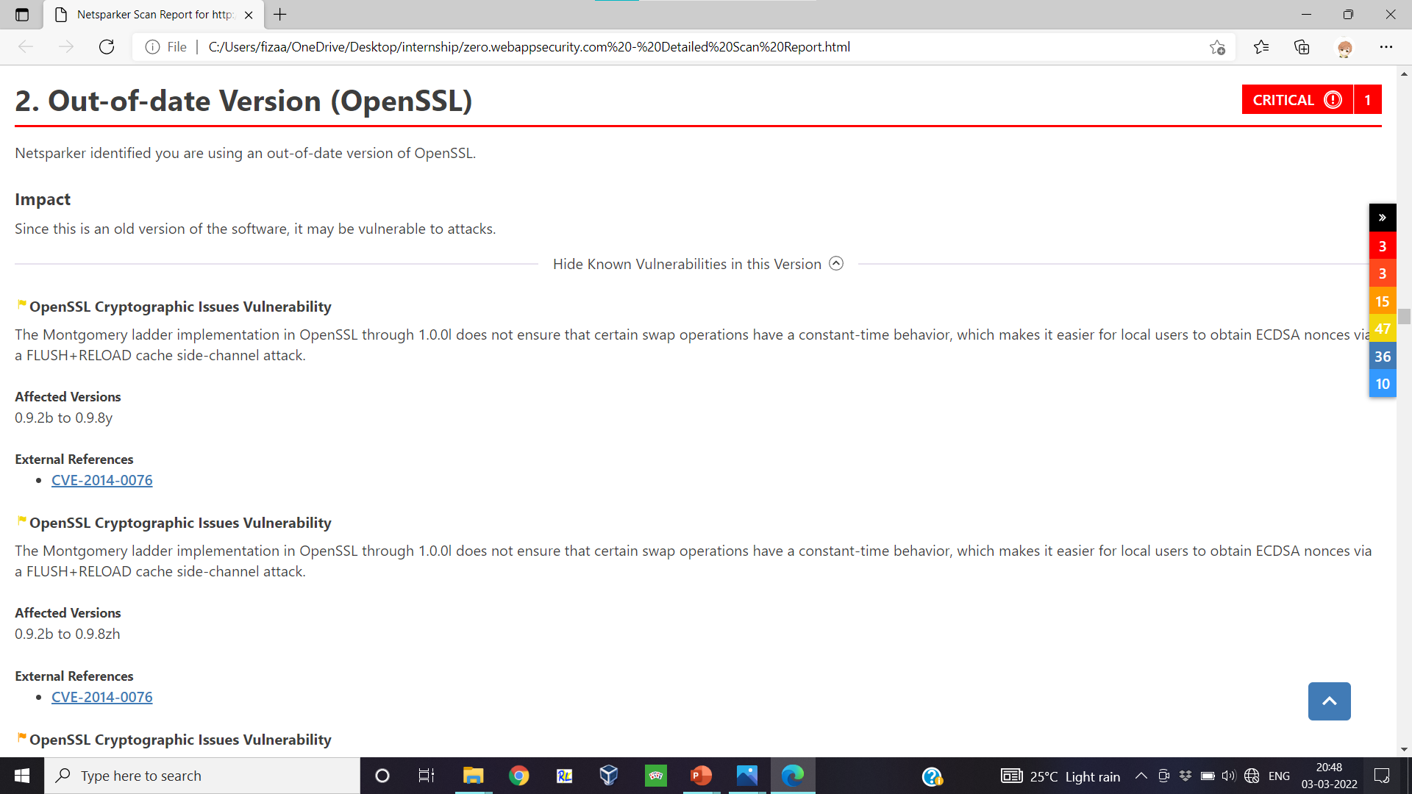

Slide 6
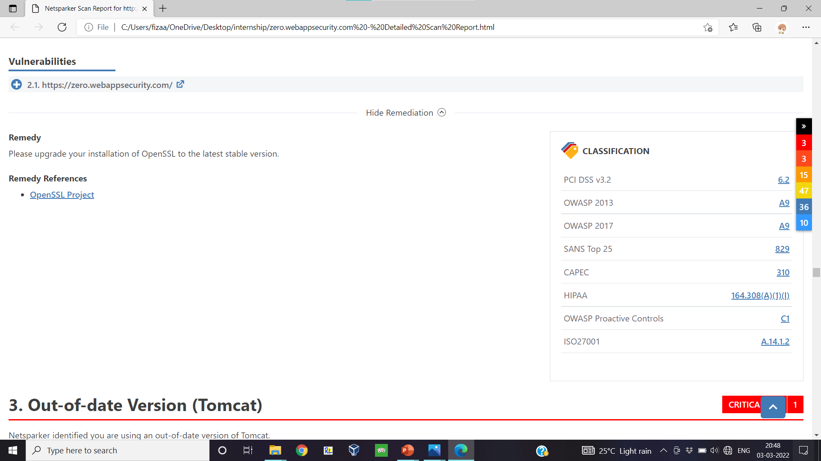

Slide 7
ABOUT VULNERABILITY SEVERITY AND THEIR IMPACT :

Slide 8
SEVERITY LEVEL: CRITICAL 1. Exploitation of the vulnerability likely results in root-level compromise of servers or infrastructure devices. 2. Exploitation is usually straightforward, in the sense that the attacker does not need any special authentication credentials or knowledge about individual victims, and does not need to persuade a target user, for example via social engineering, into performing any special functions. SEVERITY LEVEL: HIGH 1. The vulnerability is difficult to exploit. 2. Exploitation could result in elevated privileges. 3. Exploitation could result in a significant data loss or downtime. SEVERITY LEVEL: MEDIUM 1. Vulnerabilities that require the attacker to manipulate individual victims via social engineering tactics. 2. Denial of service vulnerabilities that are difficult to set up. 3. Exploits that require an attacker to reside on the same local network as the victim. 4. Vulnerabilities where exploitation provides only very limited access. 5. Vulnerabilities that require user privileges for successful exploitation. SEVERITY LEVEL: LOW 1. Vulnerabilities in the low range typically have very little impact on an organization's business. 2. Exploitation of such vulnerabilities usually requires local or physical system access.
CVSS V3 SCORE RANGE | SEVERITY
0.1 - 3.9 | Low
4.0 - 6.9 | Medium
7.0 - 8.9 | High
9.0 - 10.0 | Critical

Slide 9
Report generated by my own :

Slide 10
TITLE : out of date version (open SSL)
DOMAIN : https://zero.webappsecurity.com/
STEPS TO REPRODUCE :
STEP 1: Open NETSPARKER( Automatic Vulnerability Scanner).
STEP 2: Add the website you want to scan to the dialogue box. In our case https://zero.webappsecurity.com/
STEP 3: Define the customization options to scan.
STEP 4: Click on Start attack.
STEP 5: During the scanning many vulnerabilities of different level will start appearing.
IMPACT :
Out of date version is a security vulnerability . Hackers are always in search of devices using outdated software. There are even platforms like MITRE and NIST that keep lists of software, their versions, and the vulnerabilities they suffer from (known as Common Vulnerabilities and Exposures or CVEs).
Some of the common ways an attacker can exploit outdated software vulnerabilities: 1. Deploy attacks like SQL injections 2. Cross-site scripting (XSS) 3. Cross-site request forgery (CSRF) 4. Man-in-the-browser attack 5. Man-in-the-middle attack 6. Access your device remotely
We often think updates are just for tweaking appearance or features and forget about the security part: an updated piece of software has bugs and errors patched, and vulnerabilities removed. If we don’t update our software, we readily give hackers the easiest ways to attack our website, network, and devices.

Slide 11
A security vulnerability means any weak area of your system that attackers can exploit. There are many types of vulnerabilities :
Errors in codes
System misconfiguration
Weak passwords
Lack of input validation
Expired SSL/TLS certificate
One common security vulnerability is outdated third-party software. After a vulnerability is found or disclosed, the software publisher is expected to fix the issue and publish an updated version of the software. It’s vital to install the updated version, if we don’t and keep working with the old version, we have an outdated software vulnerability.
These vulnerabilities can affect any type of software, including operating systems, web application servers, CMS, APIs, web browsers, etc.

